Slide 1


Aldo Gonzáles
04/02/2024

Slide 2
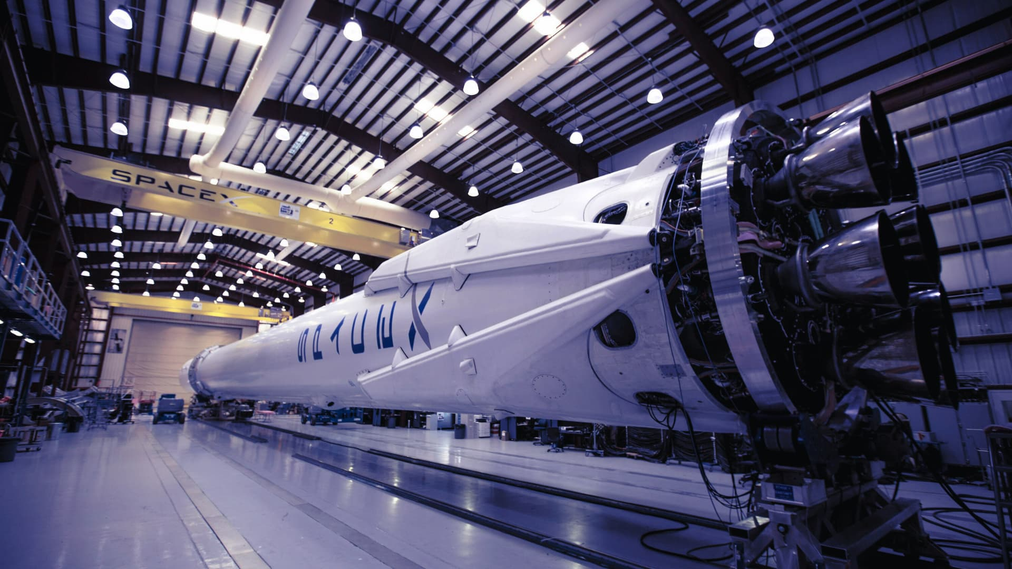
Outline
Executive Summary
Introduction
Methodology
Results
Conclusion
Appendix

Slide 3
Executive Summary
Summary of methodologies:
For Data Collection were used:
First source used for Data Collection was the Space X REST API that provide us with information about rocket used, payload delivered, launch specifications, landing specifications, and landing outcome.
To obtain necessary data will use the requests library to obtain launch data of a response in JSON format with .json() method then will be converted into a Dataframe.
Another source for Data Collection is Web scraping, a Python BeautifulSoup package will be used, which will extract HTML tables.

Slide 4
Executive Summary
Summary of methodologies:
For EDA with Data Visualization we used:
Scatter plot, Bar chart and Line chart.
For EDA with SQL:
Next commands were used: SELECT, FROM, WHERE, DISTINCT, AS, AND, BETWEEN, GROUP BY, ORDER BY, DESC, SUM(), AVG(), MIN(), COUNT(), MAX(), SUBSTR().
For Interactive Map with Folium following objects were used:
Circle, Marker, Popup, MarkerCluster, Mouse Position, PolyLine

Slide 5
Executive Summary
Summary of methodologies:
To Build a Dashboard with Plotly Dash, next plots/graphs and interactions were used:
Dropdown list, Pie chart, Slider, Scatter chart
For Predictive Analysis (Classification) were used the following models:
Logistic regression, Support vector machine, Decision tree classifier, K nearest neighbors.
For choose the best parameters will use the GridSearchCV() object and .score() object for test set sccuracy.

Slide 6
Executive Summary
Summary of all results:
The first results were obtained using the SQL extension:
SpaceX has four main launch sites, located mainly in the state of Florida, the main Payload mass moving sites are KSC LC-39A and CCAFS SLC-40.
The total Payload Mass for customer NASA CRS was 45,596 kg, which represents the third Customer in terms of Payload Mass. Including other areas (CCDev, CCP, CCD and CTS), NASA is SpaceX's main customer.
The average Payload Mass carried by version F9 v1.1 is 2,534.66 kilograms. It is the second to be minor after version F9 v1.0.

Slide 7
Executive Summary
Summary of all results:
The date of First successful landing in ground pad was 2015-12-22.
The Booster versions with payload mass between 4,000 to 6,000 kilograms was listed.
The Number of successful missions is 99 and one mission was failure in flight.
Twelve Booster Version have the maximum payload mass of 15,600 kilograms.
30 landing outcomes was rank between 2010-06-04 and 2017-03-20.
Interactive analytics were displayed, one for all sites and the other for CCAFS LC-40 site.

Slide 8
Executive Summary
Summary of all results:
The Confusion Matrix was elaborated for four models (Logistic regression, Support vector machine, Decision Tree classifier and K nearest neighbors):
The best model was the Decision Tree classifier with only one false negative. The best parameters are:
Criterion: gini
Max depth: 16
Max features: log2
Min samples leaf: 1
Min sample split: 10
Splitter: best

Slide 9
Introduction
Project background and context:
There are already some companies that offer space travel, to the people and by providing satellites.
One of the most successful is SpaceX, which announces launches of Falcon 9 rockets at cost of $62 million, while the competition does so at more than $165 million each.
Part of the savings is because SpaceX is reusing the first stage with some success, lowering the cost of launches.

Slide 10
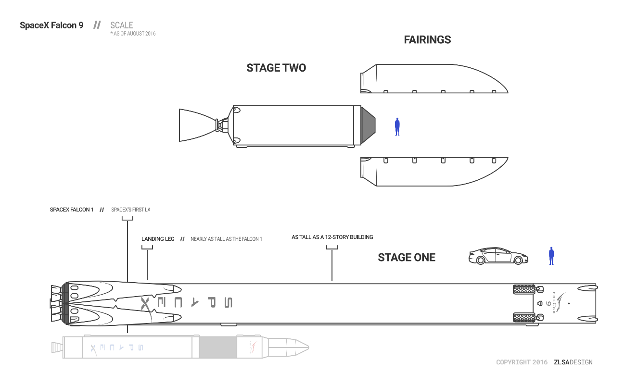
Introduction
SpaceX Falcon 9 scheme:

Slide 11
Introduction
Want to find answers for:
The Project purpose is create models to predict success in the first stage landings.
Knowing the success in landings, we will know the costs involved in missions.

Slide 12

Section 1

Slide 13
Methodology
Executive Summary
Data Collection
Data Collection – SpaceX API
Data Collection – Scraping
Data Wrangling
EDA with Data Visualization
EDA with SQL

Slide 14
Methodology
Executive Summary
Build an Interactive Map with Folium
Build a Dashboard with Plotly Dash
Predictive Analysis (Classification)
Results

Slide 15
Data Collection
Was used three sources:
Space X REST API that will provide rocket launch information
The requests library to obtain the launch data of a response in JSON format.
Web scraping with Python BeautifulSoup package

Slide 16
Data Collection – SpaceX API
For Data Collection were used some APIs like "API_call_spacex_api.json” . Also used some commands to create a Data frame with this data:
Also used some others APIs:
https://api.spacexdata.com/v4/rockets/[rocket number].json
https://api.spacexdata.com/v4/launchpads/[launchpad number].json
https://api.spacexdata.com/v4/payloads/[payloads number].json
https://api.spacexdata.com/v4/cores/[core number].json

Slide 17
Data Collection – SpaceX API
Import Libraries: requests, pandas, numpy, datetime
Processing data: Unique values, date before 2020/11/13
Create lists with variable needed:
Date, BoosterVersion, PayloadMass, Orbit, LaunchSite, Outcome, Flights, GridFins, Reused, Legs, LandingPad, Block, ReusedCount, Serial, Longitude, Latitude
Create dictionary "launch_dict"
Create Dataframe "launch_df" from "launch_dict"
Processing data: BoosterVersion equal to Falcon 9, replace null values in "PayloadMass" with mean
Extract data with APIs: API_call_spacex_api.json,
[rocket number].json, [launchpad number].json, [payloads number].json,
[core number].json
Processed Data in Data Frame "data_falcon9 "

Slide 18
Data Collection – SpaceX API
The link to enter the Data Collection – SpaceX API on GitHub is:
https://github.com/AldoGonzales/ADS_Capstone/blob/0050a6d5f51ec3631279e8c88a4626604cfe2866/Week%201%20Lab%201%20Collecting%20the%20data%20.ipynb

Slide 19
Data Collection - Scraping
For Data Collection with Scraping were used GET method for extract data from Wiki page (List of Falcon 9 and Falcon Heavy launches) and assign to a Data frame. Also created a BeautifulSoup object for work with HTML data:
Entire contents of the BeautifulSoup object are assigned to the html_tables variable:
A dictionary will be created that will join all the tables that interest us from the Wikipage (launch_dict):

Slide 20
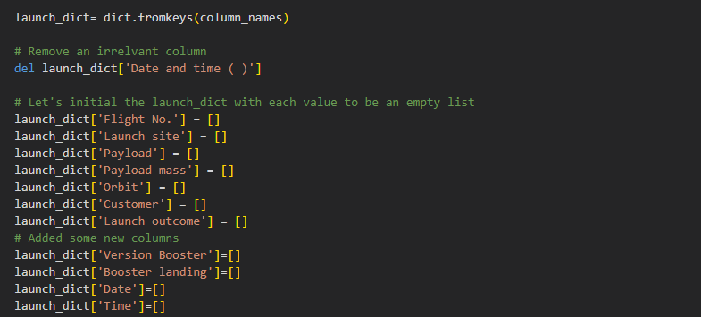
Data Collection - Scraping
A routine is created that uses the soup.find_all() function that searches for tables with the class "wikitable plainrowheaders collapsible" which are the tables that interest us:

Slide 21
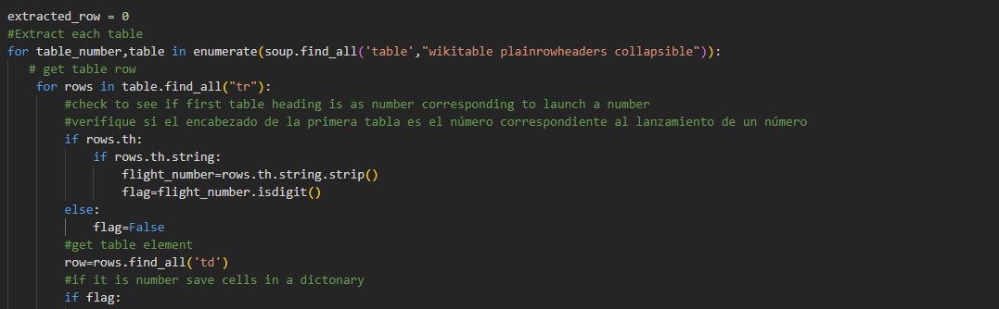
Data Collection - Scraping
The following values are assigned to each row and position of the "launch_dict" dictionary: “Flight No.”, “Date”, “Time”, “Version Booster”, “Launch site”, “Payload”, “Payload mass”, “Orbit”, “Customer”, “Launch outcome” and “Booster landing”

Slide 22
Data Collection - Scraping
Finally we create the Dataframe “df1” with all data from dictionary “launch_dict”:
The link to enter Complete the Data Collection with Web Scraping on GitHub is:
https://github.com/AldoGonzales/ADS_Capstone/blob/main/Week%201%20Data%20Collection%20with%20Web%20Scraping.ipynb

Slide 23
Data Collection – Scraping
Import Packages: beautifulsoup4 and requests
Create Dictionary “launch_dict” that will join all tables that interest us from the Wiki page
Import Libraries: sys, requests, BeautifulSoup, re, Unicode data y pandas
A routine is created that uses the soup.find_all() function to extract data from tables with class "wikitable plainrowheaders collapsible" and assign to dictionary "launch_dict"
Use GET method to extract data from Wiki page
A BeautifulSoup object is created
Obtain column titles with extract_column_from_header() function that extracts the information from the rows with label “th” and assigns it to the column_names list
Finally we assign the content of the dictionary “launch_dict” to the Data frame “df1”

Slide 24
Data Wrangling
After import libraries pandas and numpy import CSV file and assign to Data frame "df":
Below are some reports obtained from the Data frame:
Number of launches on each site:

Slide 25
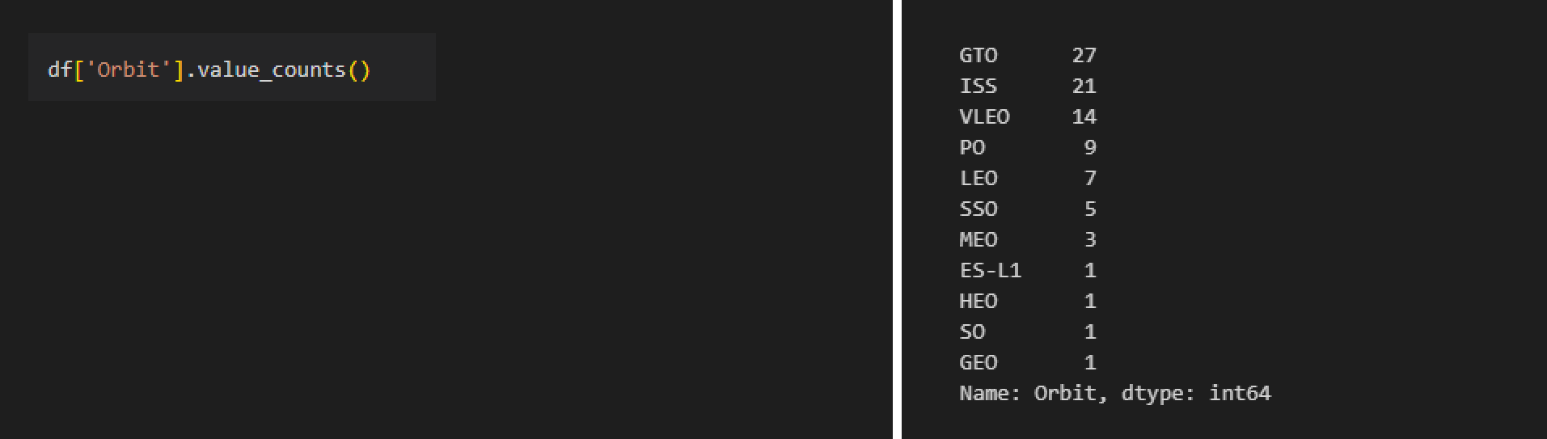
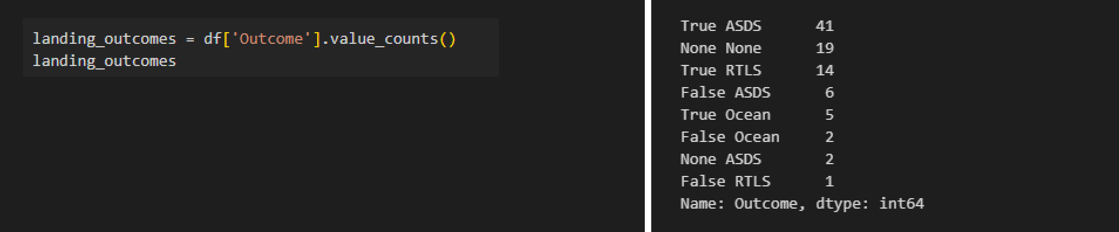
Data Wrangling
Number and occurrence of each orbit (more explanation at Appendix - Orbit Types )
Number and occurrence of mission outcome of the orbits:

Slide 26
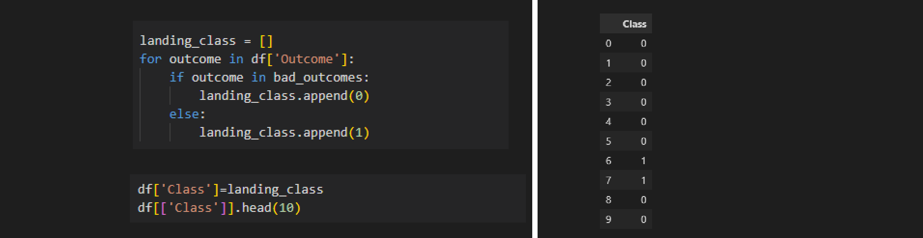
Data Wrangling
Create a landing outcome label from Outcome column:
Determine the success rate:
The link to enter Complete the Data Collection with Web Scraping on GitHub is:
https://github.com/AldoGonzales/ADS_Capstone/blob/main/Week%201%20Lab%202%20Data%20wrangling.ipynb

Slide 27
Data Wrangling
Import Libraries: pandas and numpy
Calculate the number and occurrence of each orbit
Load the CSV file to the Dataframe 'df'
Calculate the number and occurrence of mission outcome of the orbits
Check variable types using 'df.dtypes' and the percentage of missing data
Create a landing outcome label from Outcome column
Calculate number of launches for each SpaceX facility
Determine the success rate
Calculate the number and occurrence of each orbit

Slide 28
EDA with Data Visualization
The plots used to visualize obtained data are the following:
Scatter plot - “FlightNumber” vs “Payload”
Scatter plot - “FlightNumber” vs “Launch Site”
Scatter plot - “Payload Mass (kg)” y “Launch Site”
Bar chart - “Orbit type” with Success rate
Scatter plot - “Flight Number” vs “Orbit Type”
Scatter plot - “Payload Mass” vs “Orbit Type”
Line chart – “Yearly Success rate”

Slide 29
EDA with Data Visualization
The plots used to visualize obtained data are the following:
Scatter plot was used because it's the best for showing the relationship between two variables in a cartesian plane.
The bar chart is ideal for comparing categorical values like Orbit Type.
The Line chart was used for showing time series such as the year in this case.
The link to enter completed EDA with data visualization notebook on GitHub is:
https://github.com/AldoGonzales/ADS_Capstone/blob/main/Week%202%20EDA%20with%20Visualization%20Lab.ipynb

Slide 30
EDA with SQL
Next the SQL performed queries using Database in CSV format:
Display the names of launch sites:
Display 5 records where launch sites begin with the string 'CCA':
Display the total payload mass carried by boosters launched by NASA (CRS):

Slide 31
EDA with SQL
Display average payload mass carried by booster version F9 v1.1:
List the date when the first successful landing outcome in ground pad was achieved:
List the names of the boosters which have success in drone ship and have payload mass greater than 4000 but less than 6000:

Slide 32
EDA with SQL
List the total number of successful and failure mission outcomes:
List the names of the booster_versions which have carried the maximum payload mass:
List the records which will display the month names, failure landing_outcomes in drone ship, booster versions, launch_site for the months in year 2015:

Slide 33
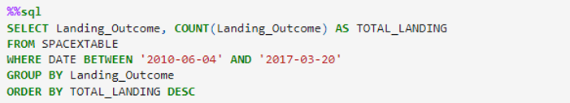
EDA with SQL
Rank the count of landing outcomes between the date 2010-06-04 and 2017-03-20, in descending order:
The link to enter SQL Notebook on GitHub is:
https://github.com/AldoGonzales/ADS_Capstone/blob/main/Week%202%20Assignment%20SQL%20Notebook%20for%20Peer%20Assignment.ipynb

Slide 34
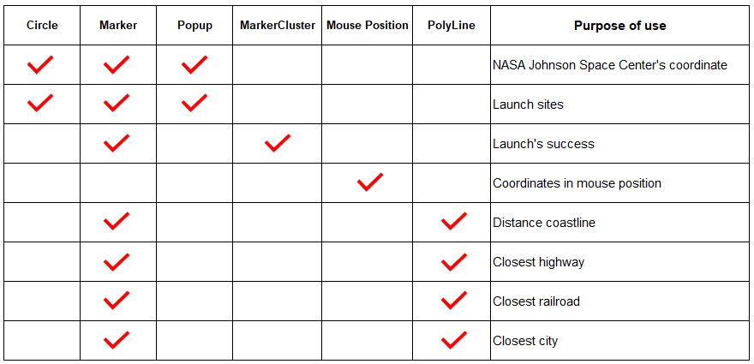
Build an Interactive Map with Folium
The next table summarize the map objects used:

Slide 35
Build an Interactive Map with Folium
The following objects were used for:
Marker: Is used for show important places on map.
Popup: This object is used for unfold information when click.
Circle: This object is used for show a circle around given coordinates.
MakerCluster: Is used for clustering sites with numerical values showing the total sum when map is zoom out.
Mouse Position: This object is used for showing latitude and longitude information on map.
PolyLine: Is used for draw a line on map. In this case was used for show distance between two points on map.

Slide 36
Build an Interactive Map with Folium
The link to enter to Launch Sites Locations Analysis with Folium on GitHub is:
https://github.com/AldoGonzales/ADS_Capstone/blob/main/Week%203%20Launch%20Sites%20Locations%20Analysis%20with%20Folium.ipynb

Slide 37
Build a Dashboard with Plotly Dash
The plots/graphs and interactions used:
Un Dropdown list for choosing one launch site or all sites from a list so can show a Pie chart graph with this selected site.
A Pie chart showing percentage of successful launches on each site. Or the success rate in launching each site if "All Sites" is selected.
A Slider to select a range for the Payload between zero and 10K kilograms. It can choose a minimum and a maximum value.
A Scatter chart showing the relationship between payload mass and launch success. The chart also show the Booster version category using colors.

Slide 38
Build a Dashboard with Plotly Dash
The link to enter to Plotly Dash lab on GitHub is:
https://github.com/AldoGonzales/ADS_Capstone/blob/main/Week%203%20Build%20an%20Interactive%20Dashboard%20with%20Ploty%20Dash.py

Slide 39
Predictive Analysis (Classification)
'data' Dataframe was created from CSV file:
‘X' Dataframe was created from CSV file. This is the independent variables array that need to be transformed for standardize values:
'data' Dataframe was created from CSV file:

Slide 40
Predictive Analysis (Classification)
We are going to test four classification models:
Logistic regression
Support vector machine
Decision tree classifier
K nearest neighbors
Each classification model will be tested with different parameters to choose the best parameters using the GridSearchCV() object.
Once the best parameters for each model have been chosen, they will be tested on the training data.

Slide 41
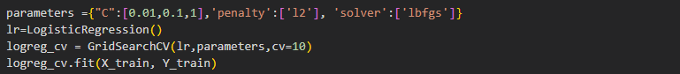
Predictive Analysis (Classification)
Logistic regression:
Support vector machine:

Slide 42
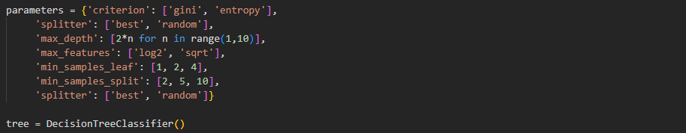
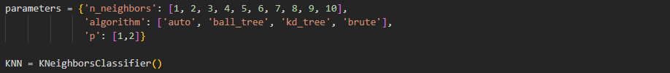
Predictive Analysis (Classification)
Decision tree classifier:
K nearest neighbors:

Slide 43
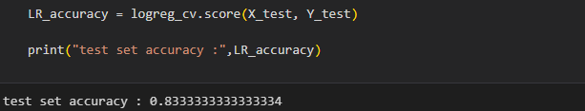
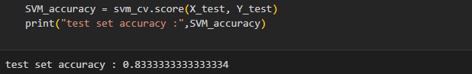
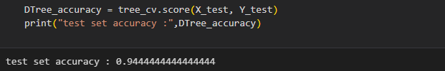
Predictive Analysis (Classification)
Finally, the accuracy will be calculated with the Test data for each model:
Logistic regression:
Support vector machine:
Decision tree classifier:

Slide 44
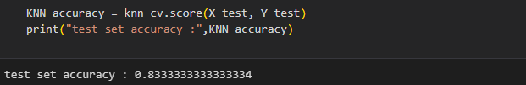
Predictive Analysis (Classification)
Finally, the accuracy will be calculated with the Test data for each model:
K nearest neighbors:

Slide 45
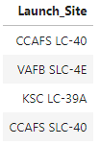
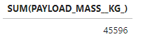
Results
Exploratory data analysis results:
LAUNCH SITES:
TOTAL PAYLOAD MASS LAUNCHED BY NASA (CRS):

Slide 46
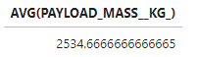
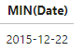
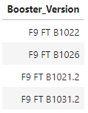
Results
AVERAGE PAYLOAD MASS CARRIED BY VERSION F9 v1.1:
FIRST SUCCESSFUL LANDING IN GROUND PAD DATE:
BOOSTERS SUCCESS IN DRONE SHIP WITH PAYLOAD MASS GREATER THAN 4000 BUT LESS THAN 6000:

Slide 47
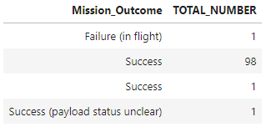
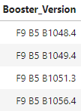
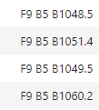
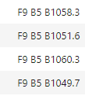
Results
NUMBER OF SUCCESSFUL AND FAILURE MISSION OUTCOMES:
BOOSTER VERSIONS WHICH HAVE CARRIED THE MAXIMUM PAYLOAD MASS:

Slide 48
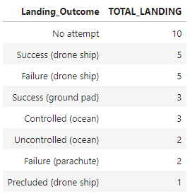
Results
RANK THE COUNT OF LANDING OUTCOMES BETWEEN THE DATE 2010-06-04 AND 2017-03-20:

Slide 49
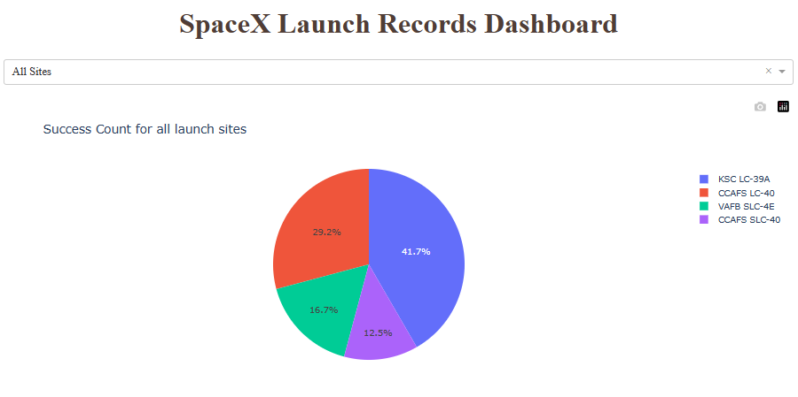
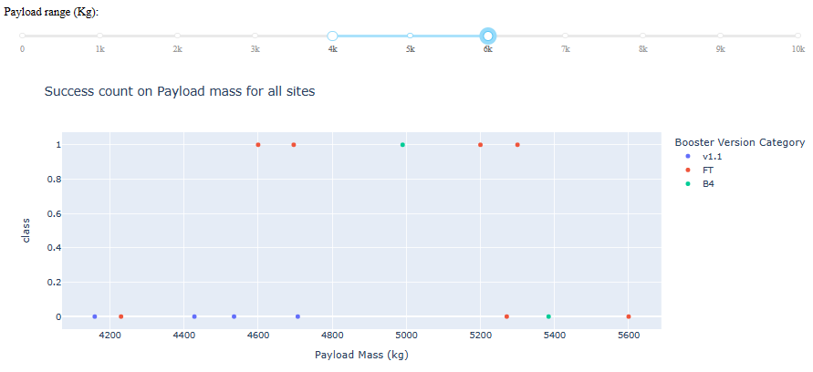
Results
Interactive analytics demo in screenshots
Next some screenshot examples of Interactive analytics:

Slide 50
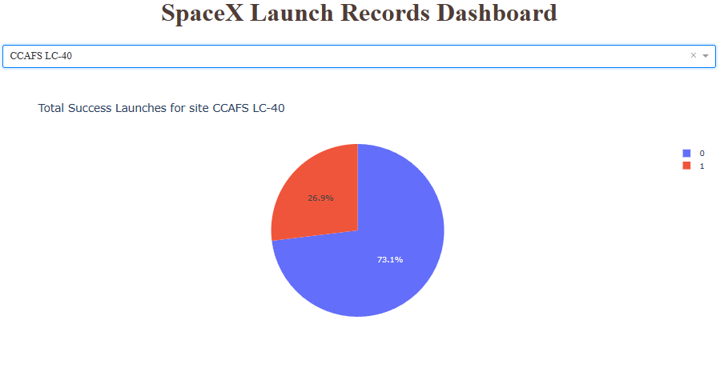
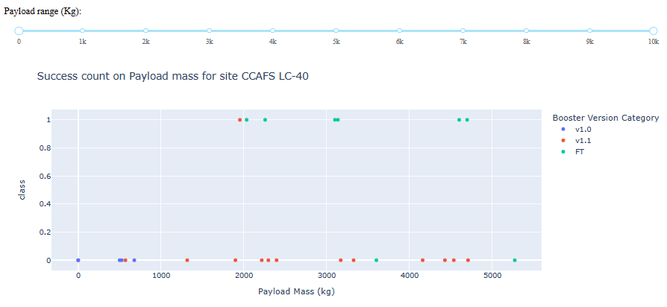
Results

Slide 51
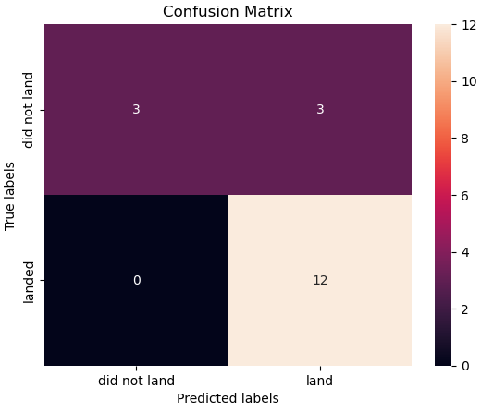
Results
Predictive analysis results
Four models were used and their best parameters were chosen:
a) Logistic regression:

Slide 52
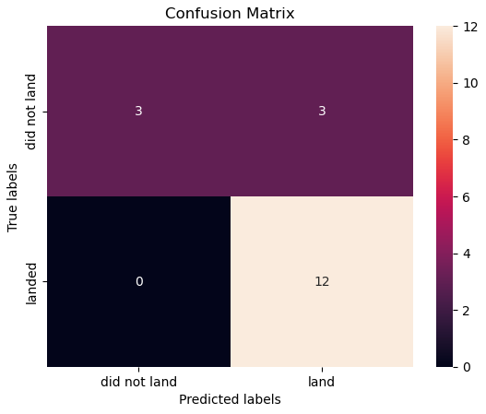
Results
b) Support vector machine:

Slide 53
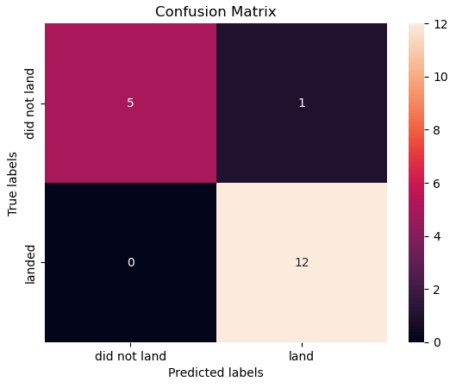
Results
c) Decision tree classifier:

Slide 54
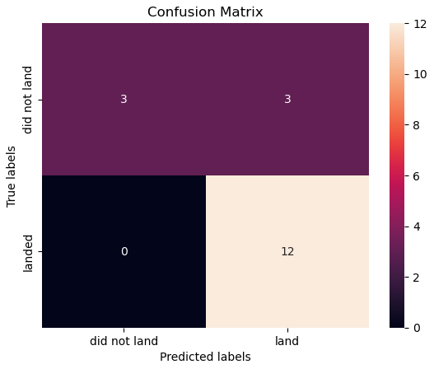
Results
d) K nearest neighbors:

Slide 55

Section 2

Slide 56
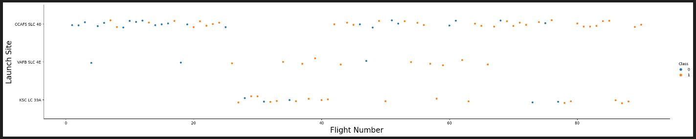
Flight Number vs. Launch Site
The flight numbers of the different missions shows on X axis.
The Launch Sites (CCAFS-SLC-40, WAFB-SLC-4E and KSC-LC-39A) are shown on Y axis.
The color of each point on the graph shows in orange whether it succeeded or failed in blue.

Slide 57
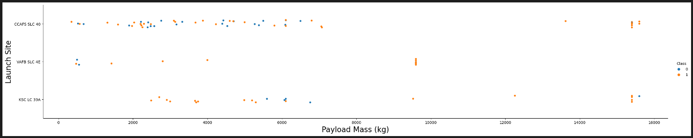
Payload vs. Launch Site
The Payload Mass is shown on X axis with values between 0 and 16,000 kilograms.
The Launch Sites (CCAFS-SLC-40, WAFB-SLC-4E and KSC-LC-39A) are shown on Y axis.
The color of each point on the graph shows in orange whether it succeeded or failed in blue.

Slide 58
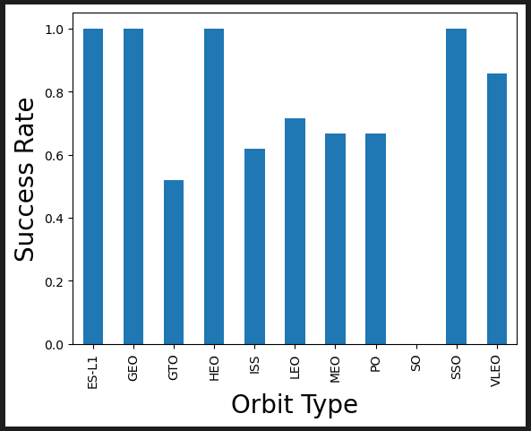
Success Rate vs. Orbit Type
Orbit Type is shown on X axis (ES-L1, GEO, GTO, HEO, ISS, LEO, MEO, PO, SO, SSO and VLEO).
The success rate is shown on Y axis, 1 means 100% of success.

Slide 59
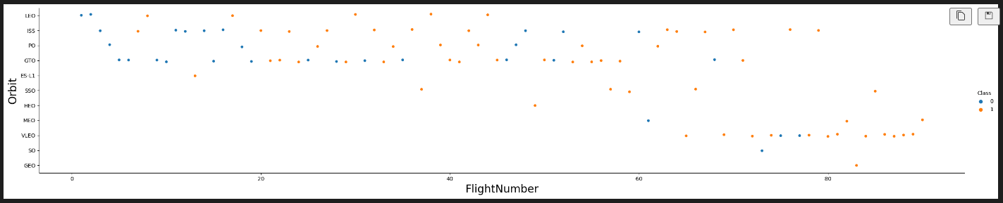
Flight Number vs. Orbit Type
Flight numbers of the different missions are shown on X axis.
Orbit Type is shown on the Y axis (LEO, ISS, PO, GTO, ES-L1, SSO, HEO, MEO, VLEO, SO and GEO).
The color of each point on the graph shows in orange whether it succeeded or failed in blue.

Slide 60
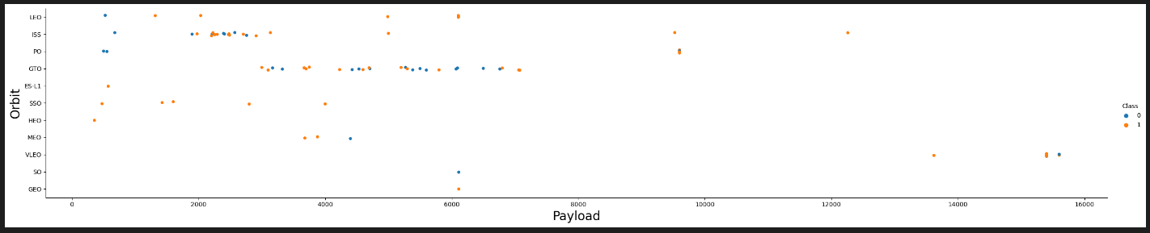
Payload vs. Orbit Type
On X axis the Payload Mass is shown with values between 0 and 16,000 kilograms.
Orbit Type is shown on the Y axis (LEO, ISS, PO, GTO, ES-L1, SSO, HEO, MEO, VLEO, SO and GEO).
The color of each point on the graph shows in orange whether it succeeded or failed in blue.

Slide 61
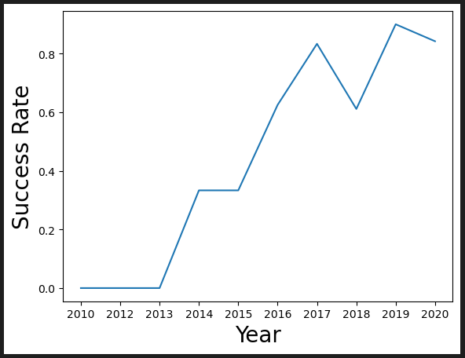
Launch Success Yearly Trend
The X axis shows the years of the missions from 2010 to 2020.
The Y axis shows the average success rate for each year, with 1 being 100%.

Slide 62
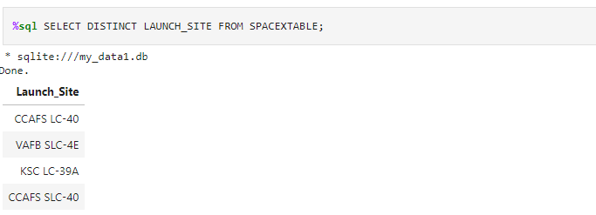
All Launch Site Names
The “DISTINCT” command was used to ensure that different values were selected from the LAUNCH_SITE field of the Database.

Slide 63
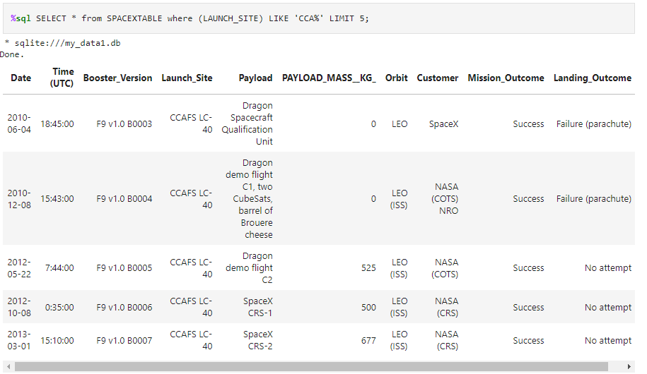
Launch Site Names Begin with 'CCA'
Used “LIKE” command to select sites starting with CCA% and limited to 5 records with “LIMIT 5” command.

Slide 64
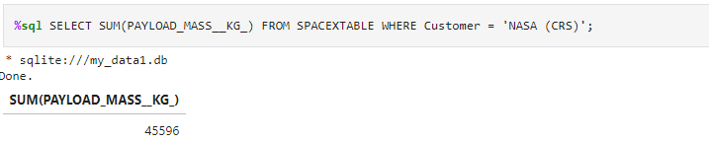
Total Payload Mass
The “SUM()” command is used to calculate the total weight and “WHERE” command to indicate that we want the Customer to be NASA (CRS).

Slide 65
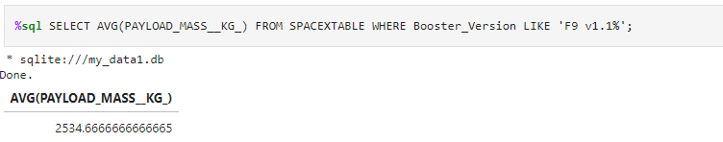
Average Payload Mass by F9 v1.1
The “AVG()” command was used to calculate the average payload mass carried and “LIKE” command to take the Booster_Version that starts with “F9 v1.1%”.

Slide 66
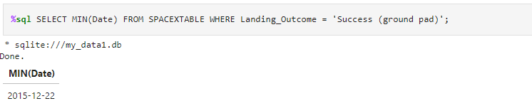
First Successful Ground Landing Date
The “MIN()” command was used to select minimum value of the date and “WHERE” command to indicate that “Landing_Outcome” should be equal to “Success (ground pad)”.

Slide 67
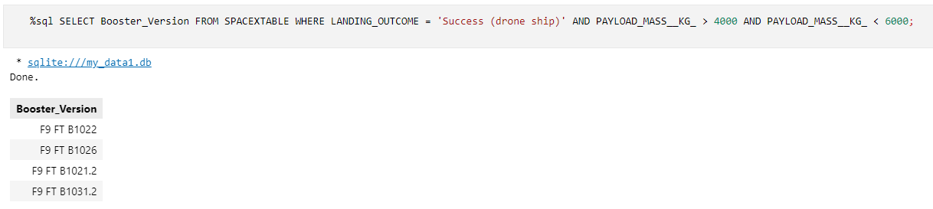
Successful Drone Ship Landing with Payload between 4000 and 6000
The “WHERE” command was used to select the boosters that have the “LANDING_OUTCOME” equal to “Success (drone ship)” and “PAYLOAD_MASS__KG_” between 4,000 and 6,000 kilograms.

Slide 68
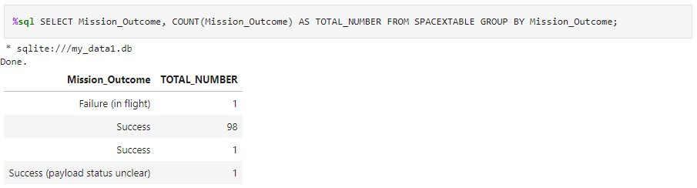
Total Number of Successful and Failure Mission Outcomes
The “COUNT()” command was used to obtain the number of missions and “GROUP BY” command to have them grouped by Outcome type.

Slide 69
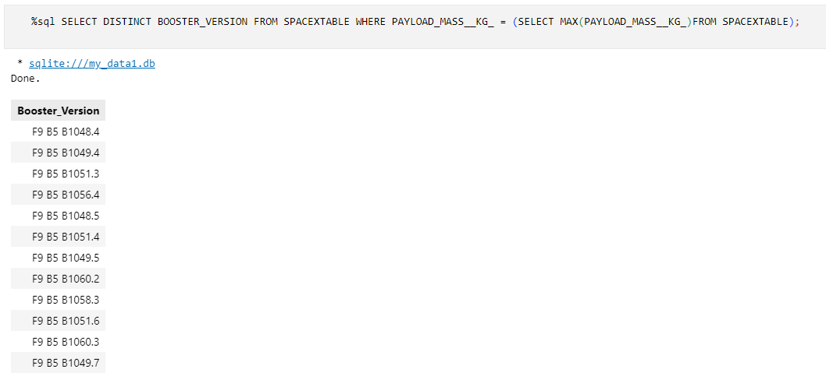
Boosters Carried Maximum Payload
The “DISTINCT” command was used to obtain the different Boosters without repeating and the “MAX()” command was used to obtain maximum value of Payload mass. It is important to mention that a subquery was used to be able to perform the query in a single line of instruction (nested queries).

Slide 70
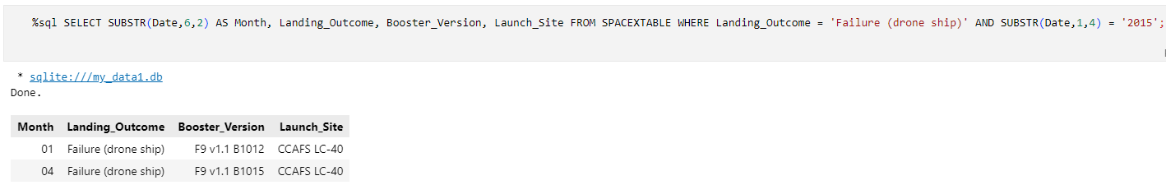
2015 Launch Records
The “SUBSTR()” command was used to obtain the value of the month and year of the “Date” column, the “WHERE” command used to select the data “Failure (drone ship)” and the year “2015” .

Slide 71
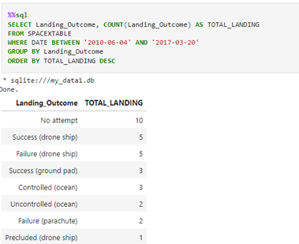
Rank Landing Outcomes Between 2010-06-04 and 2017-03-20
The “COUNT()” command was used to count the Outcome amount. The “WHERE” command was used to select Date values with “BETWEEN” command for date range. The “GROUP BY” command was also used to group the Outcome into unique and ordered values using the “ORDER BY” and “DESC” commands.

Slide 72

Section 3

Slide 73


Space X Launch Sites:
For each launch site, a circle, a marker and a Popup were used to indicate the name of the launch site.

Slide 74

Map with launch results:
For this map, a marker_cluster object was used to group the launches that are displayed when zoom in.
A method was also used to give a color green if the launch was successful and red if this was failed.
A marker object was also used to indicate the launch sites with their coordinates.

Slide 75

The closest railway, highway, coastline and city:
The calculate_distance() function was defined that calculates the distance between two points given by coordinates (latitude and longitude).
The coordinates of railway, highway, coastline and city closets were defined in the launch site.
The marker object was used to indicate the place we want to measure with a distance label.
The PolyLine object was also used to draw a line to the point we want to measure.

Slide 76

Section 4

Slide 77

Distribution of Launch success quantity by site
In Pie chart can see KSC LC-39A site has the highest number of successful launches (41.7%).

Slide 78

KSC LC-39A site launch success ratio
The KSC LC-39A site has the highest success ratio with 76.9%.

Slide 79

Success ratio for CCAFS LC-40 with Payload between 2,000 and 6,000 kilograms
The CCAFS LC-40 has success ratio of 26.9%. However in the Booster Version Category “FT”, with a payload between 2,000 and 6,000 kilograms, it has a success rate of 75%.

Slide 80

Success ratio for VAFB SLC-4E launch site
For VAFB SLC-4E site, which has a 40% success ratio, the “FT” version Booster represents 75% of its successes.

Slide 81

Success ratio for versions B4 and B5 on KSC LC-39A site
For KSC LC-39A site that has a success ratio of 76.9%, the Booster versions B4 and B5 have a success ratio of 100%.

Slide 82

Success ratio for Booster Version v1.0 and v1.1 in all sites
Booster Version v1.0 and v1.1 have a very low success ratio, together it is 5% on all launch sites.

Slide 83

Success ratio with payload mass between 5,000 and 7,000 in all sites
The success ratio with payload mass between 5,000 and 7,000 kilograms is low, close to 22% across all launch sites.

Slide 84

Section 5

Slide 85


Classification Accuracy
The model that has the highest Accuracy is the Decision Tree method (0.9444).

Slide 86

Confusion Matrix
Below is the Confusion Matrix for the best method, Decision Tree method that uses the following variables:
Criterion: gini
Max_depth: 12
Max_features: sqrt
Min_samples_leaf: 2
Min_samples_split: 5
Splitter: best
A visualization of Tree is on Appendix - Decision Tree visualization

Slide 87
Conclusions
Point 1
Spacex has four launch sites, although CCAFS SLC-40 is the most used (33.7%), KSC LC-39A site is highest success with 77.3% success. (Appendix - Spacex.csv Table)
Point 2
According to database Spacex.csv, the CCAFS LC-40 launch site has been used until 2016.
Point 3
It took 5 years to have a successful launch (2015-12-22).
Point 4
Over the years the Payload Mass average increased to 11,577 kilograms by 2020

Slide 88
Conclusions
Point 5
The success of KSC LC-39A launch site is due to focused on the Booster Version Categories FT, B4 and B5 with an average success of 88.9%. (Appendix - spacex_launch_dash Table)
Point 6
The model selected to make predictions regarding the success of a mission will be the Decision Tree classifier with the best parameters found.

Slide 89
Appendix
Orbit Types:
Low Earth orbit (LEO) is an Earth-centred orbit with an altitude of 2,000 km (1,200 mi) or less. Most of the manmade objects in outer space are in LEO.
Very Low Earth Orbits (VLEO) can be defined as the orbits with a mean altitude below 450 km.
A geosynchronous orbit (GTO) is a high Earth orbit that allows satellites to match Earth's rotation. Located at 22,236 miles (35,786 kilometers) above Earth's equator. At this hight satellite orbits at the same speed that the Earth.
It is a Sun-synchronous orbit (SSO or SO) is a nearly polar orbit around a planet, in which the satellite passes over any given point of the planet's surface at the same local mean solar time.
At the Lagrange points the gravitational forces of the two large bodies cancel out in such a way that a small object placed in orbit there is in equilibrium relative to the center of mass of the large bodies. ES-L1 is one such point between the sun and the earth.
A highly elliptical orbit (HEO), is an elliptic orbit with high eccentricity.

Slide 90
Appendix
Orbit Types:
ISS is a modular space station (habitable artificial satellite) in low Earth orbit. It is a multinational collaborative project between five participating space agencies.
MEO are geocentric orbits ranging in altitude from 2,000 km (1,200 mi) to just below geosynchronous orbit at 35,786 kilometers (22,236 mi). Also known as an intermediate circular orbit.
HEO are geocentric orbits above the altitude of geosynchronous orbit (35,786 km or 22,236 mi).
GEO is a circular geosynchronous orbit 35,786 kilometres (22,236 miles) above Earth's equator and following the direction of Earth's rotation.
PO is one type of satellites in which a satellite passes above or nearly above both poles of the body being orbited.

Slide 91

Appendix
Some Orbit types:

Slide 92

Appendix
Decision Tree visualization: Predictive best model:

Slide 93

Appendix
Tables with Spacex.cvs file:
Yearly total launches by Booster Version

Slide 94

Appendix
Tables with Spacex.cvs file:
Yearly total launches by site

Slide 95

Appendix
Tables with Spacex.cvs file:
Yearly launches outcomes

Slide 96

Appendix
Tables with Spacex.cvs file:
Launches outcomes by Site

Slide 97

Appendix
Tables with Spacex.cvs file:
Yearly payload mass average by Site

Slide 98
Appendix
Tables with Spacex.cvs file:
Yearly payload mass average by Site

Slide 99

Appendix
Table with spacex_launch_dash.cvs file:
Success launches from KSC LC-39A site

Slide 100


